Slide 1



JAVA PROJECT
FLAPPY BIRD IN JAVA
Presented by
Vaibhav(23BCS13386)
Downloaded by Rishav Kumar (rishavy103@gmail.com)

Slide 2
INTRODUCTION
Flappy Bird is a game application developed by Vietnamese programmer Dong Nguyen and released in 2013. The game featured a simple concept and addictive gameplay that kept players hooked for hours. The game was an instant success, with millions of downloads and even merchandise being sold.
Flappy Bird is a simple mobile game where the player controls a bird by tapping the screen to make it flap its wings and fly. The objective of the game is to navigate the bird through a series of pipes without touching them. Each time the bird passes through a pipe, the player earns a point. The game continues until the bird collides with a pipe or the ground, at which point the game is over and the player's score is displayed.
Downloaded by Rishav Kumar (rishavy103@gmail.com)

Slide 3
ROLE OF JAVA IN FLAPPY BIRD
Java is a programming language that was used to develop the original version of Flappy Bird. The game was developed using the Java-based game development framework called Swing.Java is a popular programming language for game development due to its cross-platform capabilities, robustness, and ease of use. It provides developers with a wide range of tools and libraries to create high-quality games.
Overall, Java played a significant role in the development of Flappy Bird, from creating the game's code and physics engine to designing its graphical user interface.
Downloaded by Rishav Kumar (rishavy103@gmail.com)

Slide 4

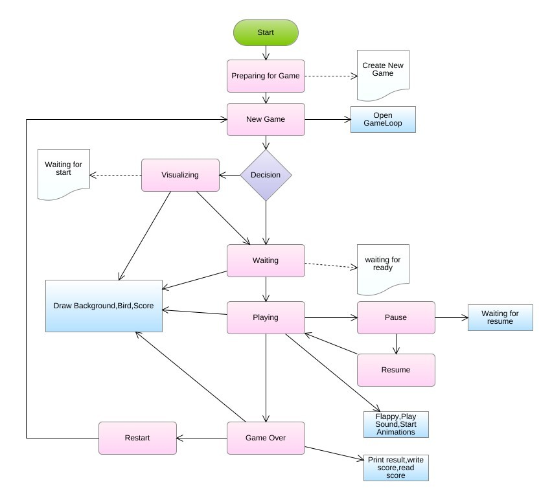
Flow Chart
Downloaded by Rishav Kumar (rishavy103@gmail.com)

Slide 5
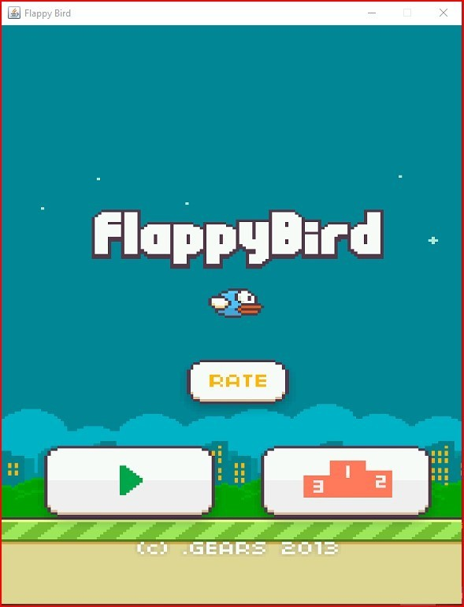
WORKING
Step 1: Run the code in any platform. It will open a GUI interface.
Downloaded by Rishav Kumar (rishavy103@gmail.com)

Slide 6
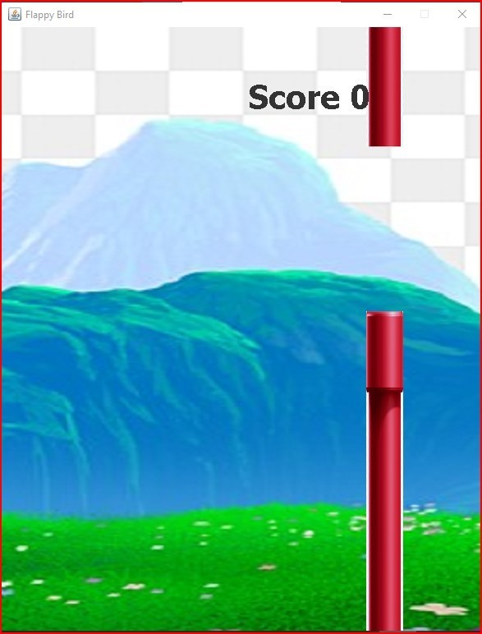
Step 2: Now click on the play button it will open a new interface in the background. The game will start you have to click the mouse to fly the bird and your objective is to navigate the bird through a series of pipes without touching them. Each time the bird passes through a pipe, the player earns a point
Downloaded by Rishav Kumar (rishavy103@gmail.com)

Slide 7
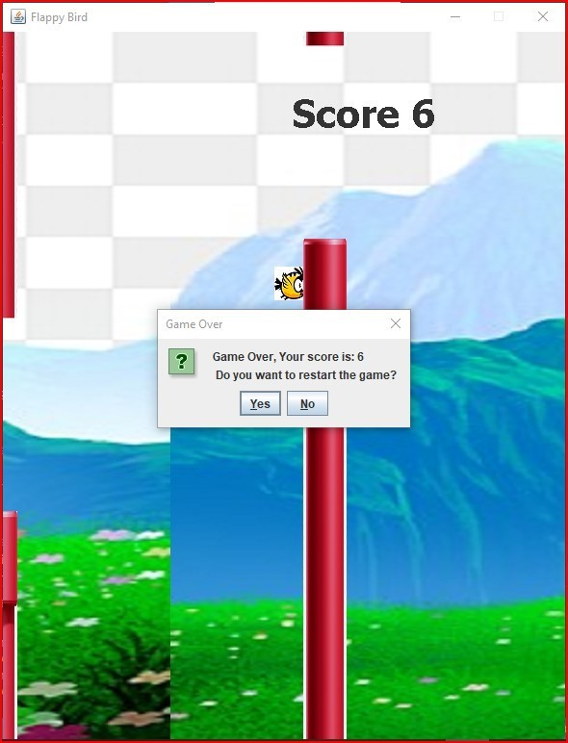
Step 3: Now if bird get collides with pipes then a pop will occur which shows the player’s score and it will ask do you want to resume the game? Click yes or no
Downloaded by Rishav Kumar (rishavy103@gmail.com)

Slide 8
CONCLUSION
In conclusion, Flappy Bird was a significant cultural phenomenon that showed the power of mobile gaming and viral marketing. It also highlighted the pressure and scrutiny that game developers can face in the age of social media and the internet. While the game is no longer available for download, its impact on the gaming industry and popular culture cannot be denied.
Downloaded by Rishav Kumar (rishavy103@gmail.com)

Slide 9

THANK YOU
Downloaded by Rishav Kumar (rishavy103@gmail.com)

